Slide 1
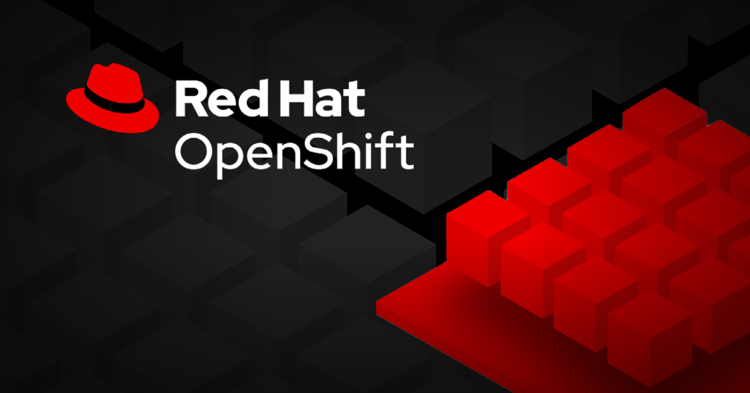
5. Manage Storage for Application Configuration Data

Slide 2
Externalize the Configuration of Applications
Configuration Maps
Configuration maps in Kubernetes are objects used to hold non-sensitive configuration data as key-value pairs, allowing you to inject this data into your containers. They make it easier to externalize configuration settings, enabling applications to be more adaptable and portable across different environments without requiring changes to the container image. One can create configuration maps using kubectl create configmap or oc create configmap commands, sourcing the data from literal values or files. They can either populate environment variables directly or be mounted as volumes, making configuration data available to applications as files, ensuring a clear separation between code and configuration.
2. Secrets
Secrets are Kubernetes objects specifically designed to store sensitive data, such as passwords, SSH keys, API tokens, and other confidential information. Unlike configuration maps, the data in secrets is stored in Base64-encoded format, but it’s not encrypted by default unless the etcd database is configured for encryption. This allows for secure handling of sensitive information with restricted access. One can create secrets using commands like kubectl create secret or oc create secret, or through the Kubernetes web console, and they can be used to populate environment variables or mounted as volumes to provide the sensitive data to applications in a secure manner.

Slide 3
Externalize the Configuration of Applications
3. Environment Variables
Environment variables in Kubernetes are essential for dynamically configuring application settings within containers. They can be initialized with values sourced from configuration maps or secrets, providing a way to manage application configurations without embedding them in the container image. This makes applications more flexible and easier to manage across different environments. One can define environment variables in a pod’s manifest using the env or envFrom attributes, allowing them to draw values from specific keys within a configuration map or secret, ensuring that configuration and sensitive data remain separate from the application code.
4. Volumes
Volumes in Kubernetes are storage units that can be attached to pods, allowing them to persist data even when containers are restarted. Both configuration maps and secrets can be mounted as volumes, enabling applications to access configuration data and sensitive information as files within the container’s file system. This is particularly useful when applications require structured data or need to read configuration settings from files rather than environment variables. The oc set volume or kubectl set volume commands are used to attach these volumes, and each key-value pair in the configuration map or secret appears as a separate file within the specified mount path, making the data readily accessible to the application.
5. Manifests
JSON or YAML files used to define the configuration of Kubernetes objects like deployments, pods, and services.

Slide 4
Externalize the Configuration of Applications
6. Opaque Secrets:
These secrets in Kubernetes are a flexible type of secret that allows you to store any kind of sensitive data as key-value pairs without imposing any specific structure or format. Unlike other secret types (e.g., TLS or Docker registry secrets, which have a predefined format), opaque secrets can hold arbitrary data like usernames, passwords, API keys, or any other sensitive information that doesn’t fit into the other predefined categories.

Slide 5
Configuration Maps
Purpose: Configuration maps are not primarily used for persistent storage but to externalize application configuration data. They allow the application configuration to be portable and manageable across different environments.
Usage: By using a configMap volume type, configuration data can be injected into pods, ensuring that configuration settings are separated from the application code. This approach is beneficial when you need to maintain different configurations for different environments without altering the container image.

Slide 6
Persistent Volumes (PVs)
A Persistent Volume (PV) is a storage resource in Kubernetes that exists independently of the lifecycle of pods, allowing data to persist even if the pod is deleted or restarted. There are two methods to provision PVs:
Static Provisioning: The cluster administrator manually creates PVs beforehand, specifying the available storage types and characteristics.
Dynamic Provisioning: PVs are created on-demand using storage classes based on the requests from Persistent Volume Claims (PVCs).
There are different storage types offer different levels of performance, reliability, and cost. Common types include:
emptyDir: Creates a directory for temporary storage that’s available as long as the pod runs. Once the pod stops, the data is lost.
hostPath: Maps a file or directory from the host node to the pod, suitable only for development or testing scenarios. It requires privileged access and is not recommended for production.
iSCSI: Offers an IP-based storage solution that allows pods to consume storage at the block level, making it suitable for applications that need high-performance storage.
local: Provides access to local storage devices such as disks or partitions but depends on the availability of the underlying node.
NFS: Provides a shared storage solution that multiple pods can access concurrently, making it ideal for applications that require shared data access.

Slide 7
Persistent Volumes (PVs)
Volume Access Modes: PVs have different access modes that determine how they can be accessed:
ReadWriteOnce (RWO): A single node can read and write to the volume.
ReadOnlyMany (ROX): Multiple nodes can read from the volume simultaneously, but writing is not allowed.
ReadWriteMany (RWX): Multiple nodes can read and write to the volume simultaneously.
Volume Modes: PVs support two volume modes:
Filesystem Mode: The default mode where the volume is mounted with a file system.
Block Mode: Provides raw block storage, allowing applications to access the volume without a file system, which can improve performance for certain workloads.

Slide 8
Persistent Volume Claims (PVCs)
A PVC is a request made by an application for a specific amount of persistent storage. PVCs abstract the complexity of storage provisioning, allowing developers to specify storage requirements without knowing the details of the underlying storage infrastructure.
A PVC belongs to a specific namespace, but multiple pods within that namespace can share the PVC, allowing data sharing across different pods. However, PVCs cannot be shared across different namespaces.
When a PVC is created, Kubernetes attempts to match it with a suitable PV that meets the requested storage size, access mode, and storage class. If no suitable PV exists, the PVC remains unbound until a compatible PV is available or created dynamically.
Developers add persistent volumes to their applications by using PVCs. They can be defined within a Kubernetes manifest or created using commands like oc set volumes. Once bound to a PV, the PVC cannot be reused by another pod until it’s released.

Slide 9
Volume Modes and Reclaim Policies
Volume Modes: Kubernetes supports two volume modes:
• Filesystem: The default mode, where the PV is mounted with a file system. It’s suitable for applications that need standard file I/O operations.
• Block: Offers raw storage without a file system, providing performance benefits for applications that implement their own storage management or require direct disk access. The block mode is specified using volumeMode: Block in the PV and PVC manifest.
Reclaim Policies:
• Retain: Keeps the PV available after a PVC is deleted, allowing for manual reclamation of the resource. This option is ideal when you need to preserve the data for manual intervention.
• Delete: Automatically deletes the PV and the associated storage resource in the external infrastructure when the PVC is deleted. This ensures that storage is released and not left unused.

Slide 10
Dynamic Provisioning and PVC Lifecycles
Dynamic Provisioning:
• Storage Classes: Dynamic provisioning relies on storage classes that define the parameters for provisioning storage. When a PVC requests a specific storage class, Kubernetes uses it to create a PV that matches the claim’s requirements.
• Provisioning Process: When a PVC is created with a specified storage class, the Kubernetes control loop automatically provisions the PV using the defined storage class parameters if an existing PV does not meet the request.
PV and PVC Lifecycles:
• Available: After a PV is created, it’s available for any PVC in the cluster.
• Bound: Once a PV is matched with a PVC, it becomes bound, and no other PVC can use it until it’s released.
• In Use: A PV remains in use while a PVC is actively bound to a pod. Deleting the PVC is prevented while it’s being used to avoid data loss.
• Released: When the PVC is deleted, the PV becomes released but is not immediately available for use until the data is cleared or the PV is manually reclaimed.
• Reclaimed: The PV enters this state based on its reclaim policy, either being retained for manual reclamation or deleted automatically.

Slide 11
Storage Classes
Storage classes in Kubernetes are used to define different types of storage options available for your cluster, allowing applications to select storage services that match their specific requirements. They act as profiles that describe the characteristics of storage, such as performance, cost, and access modes. A cluster administrator defines these storage classes to cater to different use cases, such as development, testing, and production environments. By selecting the appropriate storage class, applications can ensure that they use the most suitable storage solution without needing to know the underlying storage infrastructure details.
Why Storage Classes are Important?
• Dynamic Provisioning: Storage classes enable dynamic provisioning, allowing PVs (Persistent Volumes) to be created automatically based on application requests (PVCs).
• Flexibility: Different storage backends have varied cost, performance, and reliability levels. Storage classes let developers select a solution that matches the application’s requirements without needing to manage the infrastructure.
• Default Storage Class: Administrators define a default storage class, which Kubernetes uses to provision PVs automatically when a PVC does not specify any storage class. However, it’s recommended that developers explicitly define the storage class to avoid potential changes made by administrators.

Slide 12
Storage Class
Storage Class Parameters: The attributes of a storage class define how storage is provisioned:
• Parameters: Configure settings like file types, storage types, encryption, and replication. These parameters vary based on the specific storage provisioner being used.
• Provisioner: The provisioner attribute identifies the storage plugin or backend. It determines how storage is created. For example, kubernetes.io/aws-ebs is a common provisioner for AWS EBS volumes.
- VolumeBindingMode: Controls how volumes are bound:
Immediate: The volume is created as soon as the PVC is submitted, without waiting for the pod to be scheduled. This can be inefficient and may cause issues for topology-constrained storage.
WaitForFirstConsumer: The volume is only provisioned when a pod requests the PVC, ensuring the volume is created according to the pod’s scheduling requirements, which optimizes resource usage.
AllowVolumeExpansion: If set to true, the storage class allows the underlying storage volume to be expanded, providing flexibility for applications that may require more storage over time.

Slide 13
Using Services
- Storage classes are created by administrators to fit various use cases, such as:
• Volume Modes:
• Use block volume mode for applications requiring raw block storage for high performance.
• Use filesystem mode for applications that require file access or shared file systems.
• Quality of Service (QoS) Levels: Choose storage classes based on the performance needed, such as using SSDs for high-speed data access or HDDs for cost-effective, less frequently accessed data.
• Administrative Tiers: Use production-tier storage classes with regular backups for critical applications, while development-tier classes may not include backup services.
Kubernetes and Application Responsibilities
Kubernetes allows flexibility in how storage is accessed, but it doesn’t manage data consistency or prevent conflicting access. It’s crucial for applications to handle data integrity and ensure proper access configurations, as improper usage (e.g., mounting an RWO PVC on multiple pods) can lead to unexpected behaviors.

Slide 14
Stateful Sets
A Stateful Set in Kubernetes manages stateful applications, ensuring consistent identities (network and storage) across pods. Unlike standard deployments, stateful sets provide each pod with a unique, non-shared persistent volume (PV), maintaining its state even after rescheduling. This feature makes them ideal for applications needing consistent data storage, such as databases.
Key Characteristics:
• Consistent Identity: Each pod has a stable DNS, hostname, and unique storage, ensuring data consistency.
• Independent Persistent Volumes: Each replica in a stateful set maintains its PV, unlike deployments where volumes are shared.
Using Stateful Sets
To deploy stateful applications, Kubernetes requires a YAML manifest defining the stateful set’s configuration, including storage, replicas, container image, and environment variables.

Slide 15
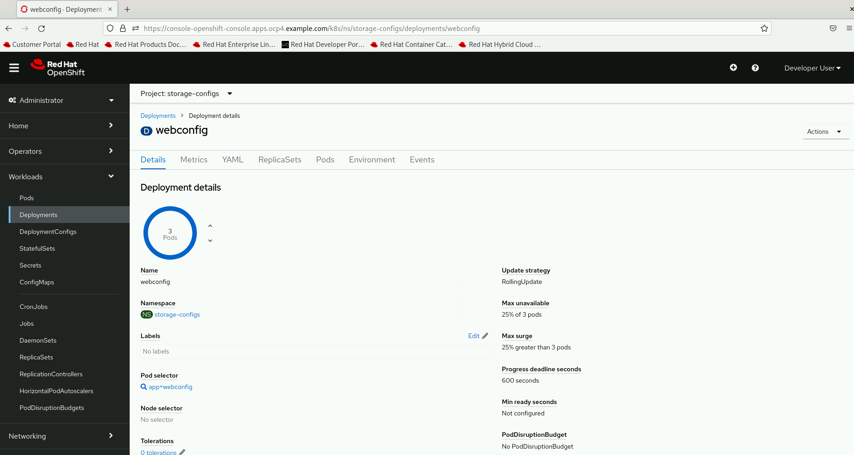
Overview of Deployment in OpenShift
This screenshot provides a view of the “webconfig” deployment details in Red Hat OpenShift under the “Deployments” section. It has 3 running pods, managed by a “RollingUpdate” strategy, which ensures updates without downtime. The deployment allows up to 25% of the pods to be unavailable and permits a 25% surge during updates, ensuring smooth scaling. There is a progress deadline of 600 seconds for updates, and no PodDisruptionBudget is configured, meaning there’s no specific protection against disruptions for these pods. This setup provides an efficient yet flexible deployment strategy for the application.

Slide 16
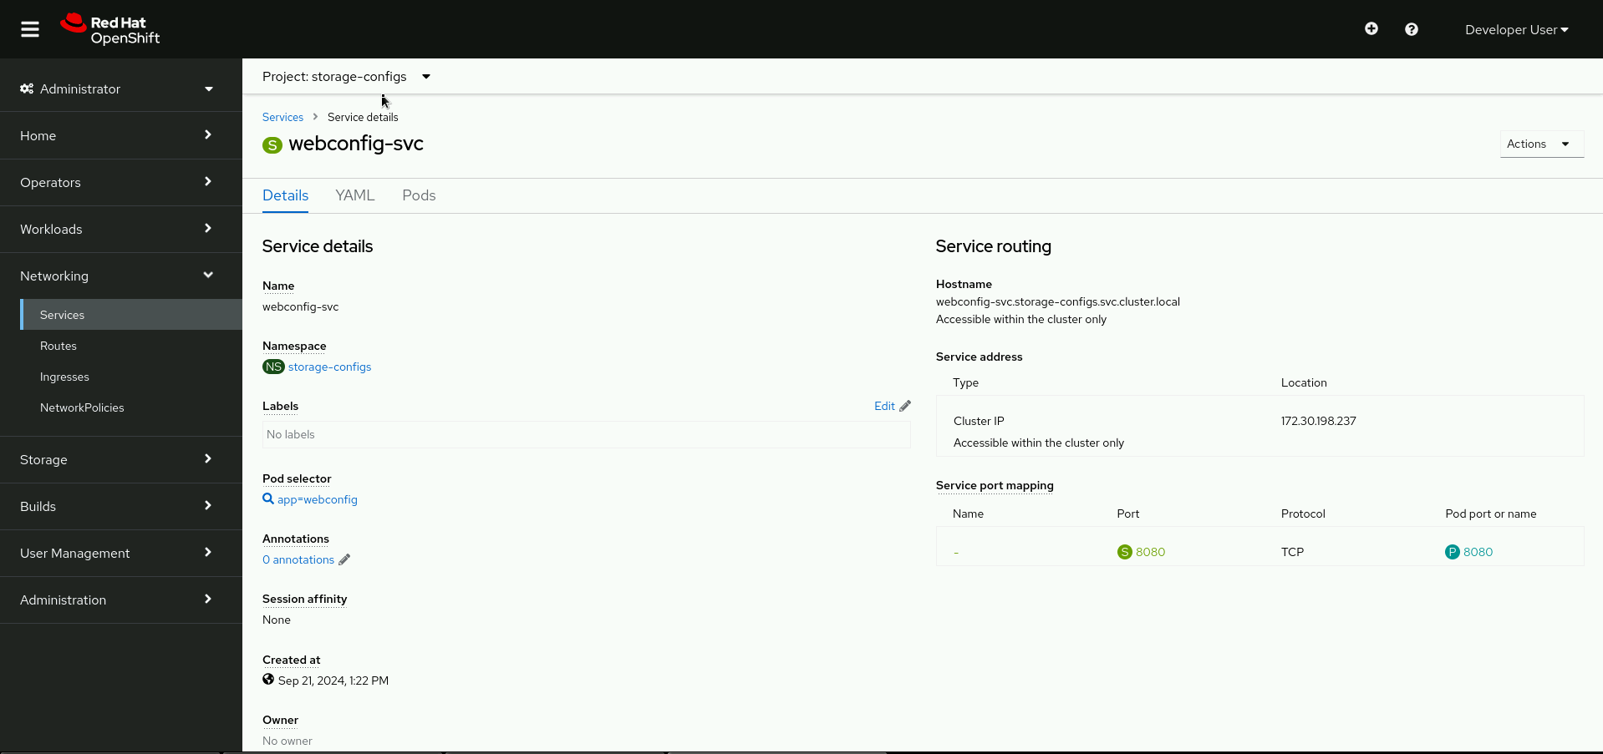
Service Overview in OpenShift
The screenshot displays the "webconfig-svc" service details within the "storage-configs" project in Red Hat OpenShift. The service operates within the "storage-configs" namespace, and its primary role is to manage communication between pods selected by the label "app=webconfig." It uses a "Cluster IP" type, making it accessible only within the cluster, with an IP address of 172.30.198.237. The service maps the port 8080 using the TCP protocol, ensuring proper routing to the corresponding pod. This setup facilitates internal networking and load balancing within the cluster for the associated application.

Slide 17
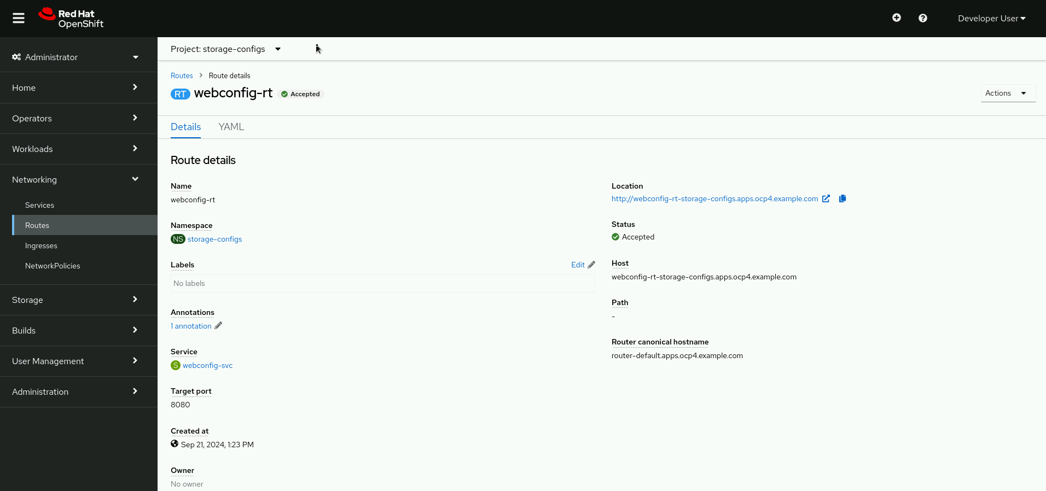
Route Overview in OpenShift
The screenshot shows the “webconfig-rt” route details for the “storage-configs” project in Red Hat OpenShift. This route is linked to the “webconfig-svc” service and exposes it externally through the URL “http://webconfig-rt-storage-configs.apps.ocp4.example.com,” which is currently in an “Accepted” status. The route operates in the “storage-configs” namespace and directs traffic to the target port 8080 of the associated service. The absence of a specified path implies that all incoming traffic to this URL will be routed to the service, ensuring external access to the application within the cluster.

Slide 18
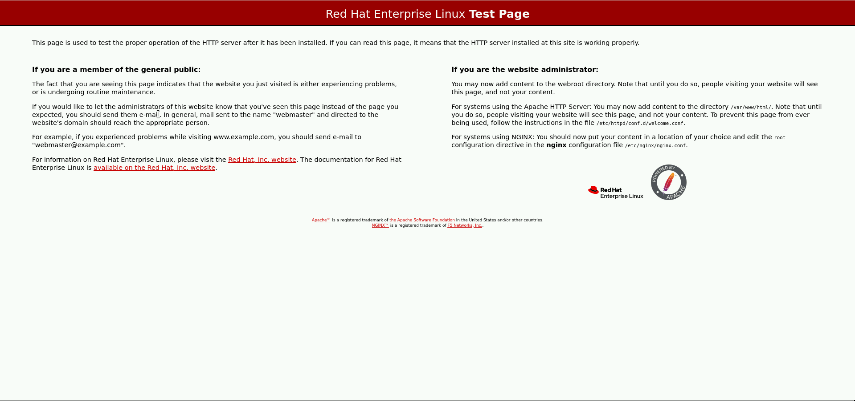
Test Page Explanation
This screenshot displays the default “Red Hat Enterprise Linux Test Page,” indicating that the HTTP server has been successfully installed and is operational.

Slide 19
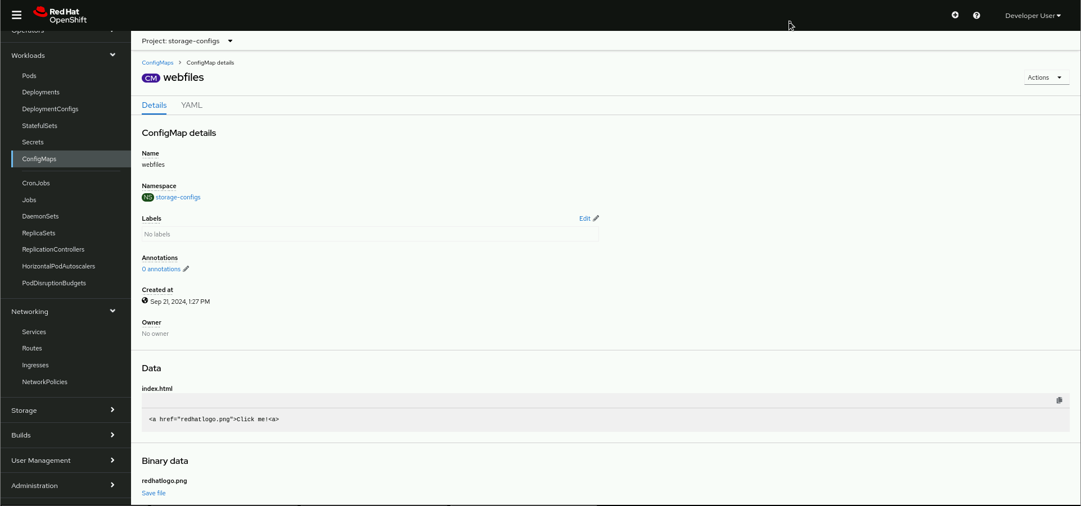
ConfigMap Overview In OpenShift
The screenshot shows the details of the “webfiles” ConfigMap in the “storage-configs” project within Red Hat OpenShift. ConfigMaps store configuration data as key-value pairs that pods can consume. In this case, the ConfigMap contains an index.html file with a hyperlink tag <a href="redhatlogo.png">click me</a>, suggesting that it links to the “redhatlogo.png” file. The binary data section confirms the presence of this image file, indicating that this ConfigMap might be used to manage static web content for the application within the cluster.

Slide 20
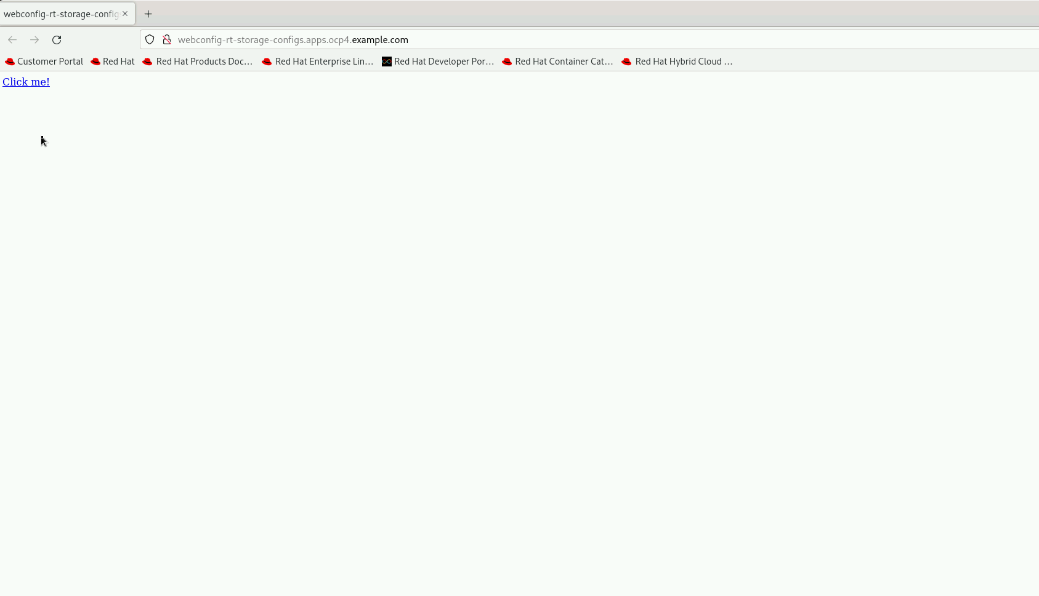
Web Page Verification of Deployed App
The screenshot displays a web page accessed via the URL http://webconfig-rt-storage-configs.apps.ocp4.example.com. This URL corresponds to the deployed OpenShift application, indicating that the service is running correctly. The page contains a simple “Click me!” link, suggesting that the deployment was successful, and the web content from the application is being served as expected. This confirms that the ConfigMap and deployment configurations were correctly set up and that the application is accessible externally.

Slide 21
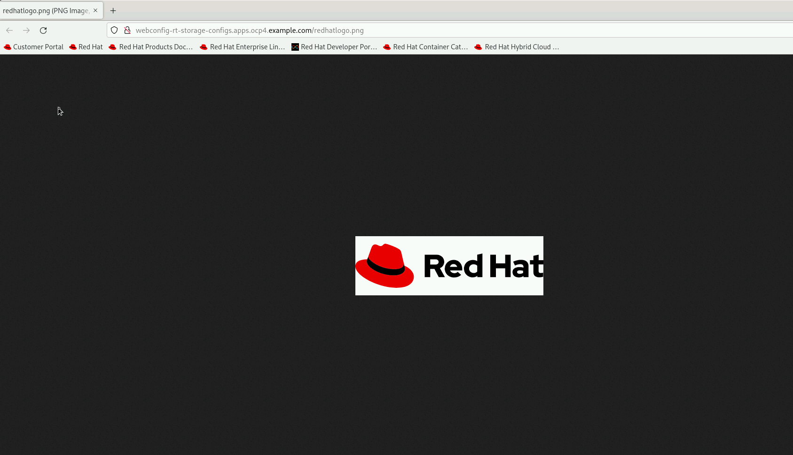
Accessing Image Content from OpenShift Deployment
The screenshot shows an image (`redhatlogo.png`) being accessed via the URL `http://webconfig-rt-storage-configs.apps.ocp4.example.com/redhatlogo.png`. This confirms that the OpenShift deployment is successfully serving static image content from the configured volume. The display of the Red Hat logo implies that the ConfigMap or other storage configuration correctly included this file, and the web server is delivering it without issues.

Slide 22
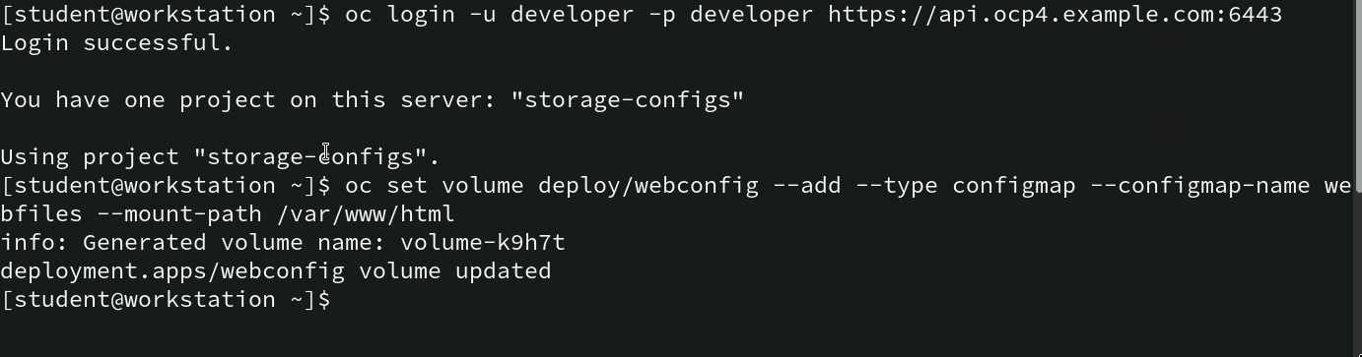
Command for mounting ConfigMap to Deployment: oc set volume
oc login -u developer -p developer https://api.ocp4.example.com:6443: This command logs into the OpenShift cluster as a developer.
oc set volume deploy/webconfig --add --type configmap --configmap-name webfiles --mount-path /var/www/html: This command adds a ConfigMap named “webfiles” as a volume to the “webconfig” deployment. The --type configmap option specifies that the volume is a ConfigMap. The --mount-path /var/www/html sets the path where the volume will be mounted inside the container.

Slide 23
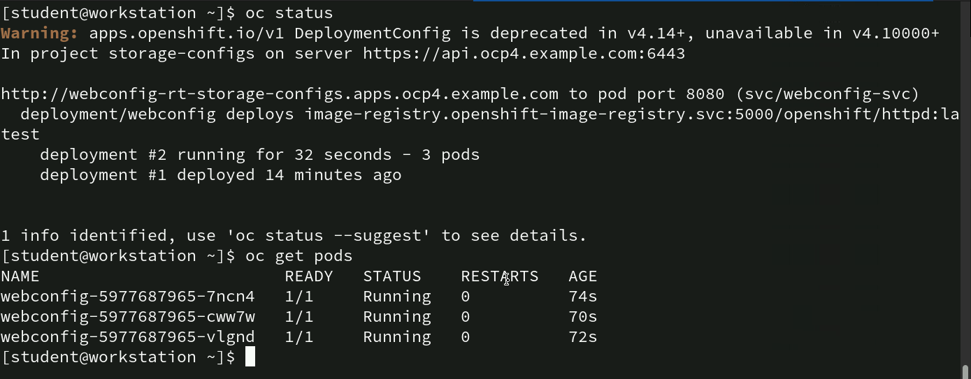
Command for checking status for deployment and pod
oc status: This command displays the current status of the OpenShift project, showing details like the active deployment, URL, service information, and image registry.
oc get pods: This command lists all pods running in the current project, providing details such as pod names, readiness status, running status, restart count, and age.

Slide 24
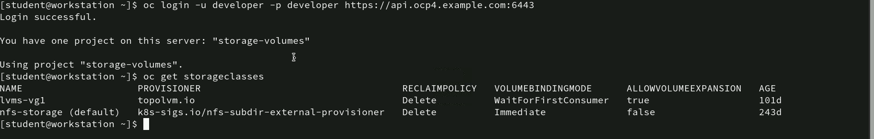
Command for checking storage classes: oc get storageclasses
The oc get storageclasses command lists two storage classes: “lvms-vg1,” which supports volume expansion and has a “WaitForFirstConsumer” mode, active for 101 days; and “nfs-storage” (default), which doesn’t support expansion and uses “Immediate” mode, active for 243 days. Both have a “Delete” reclaim policy.

Slide 25
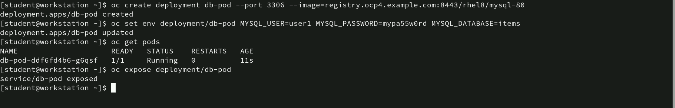
Command for creating and configuring MySQL Deployment: oc create, oc set env, oc expose
oc create deployment db-pod --port 3306 --image=registry.ocp4.example.com:8443/rhel8/mysql-80: This command creates a deployment named “db-pod” using the MySQL 8.0 image from the specified registry and exposes port 3306 for database access.
oc set env deployment/db-pod MYSQL_USER=user1 MYSQL_PASSWORD=mypa55w0rd MYSQL_DATABASE=items: This command sets environment variables for the “db-pod” deployment to configure the database with user credentials and database name.
oc get pods: This command checks the status of the pods.
oc expose deployment/db-pod: This command creates a service to expose the “db-pod” deployment, making it accessible within the OpenShift network. The service allows other pods or external applications to communicate with the MySQL database.

Slide 26
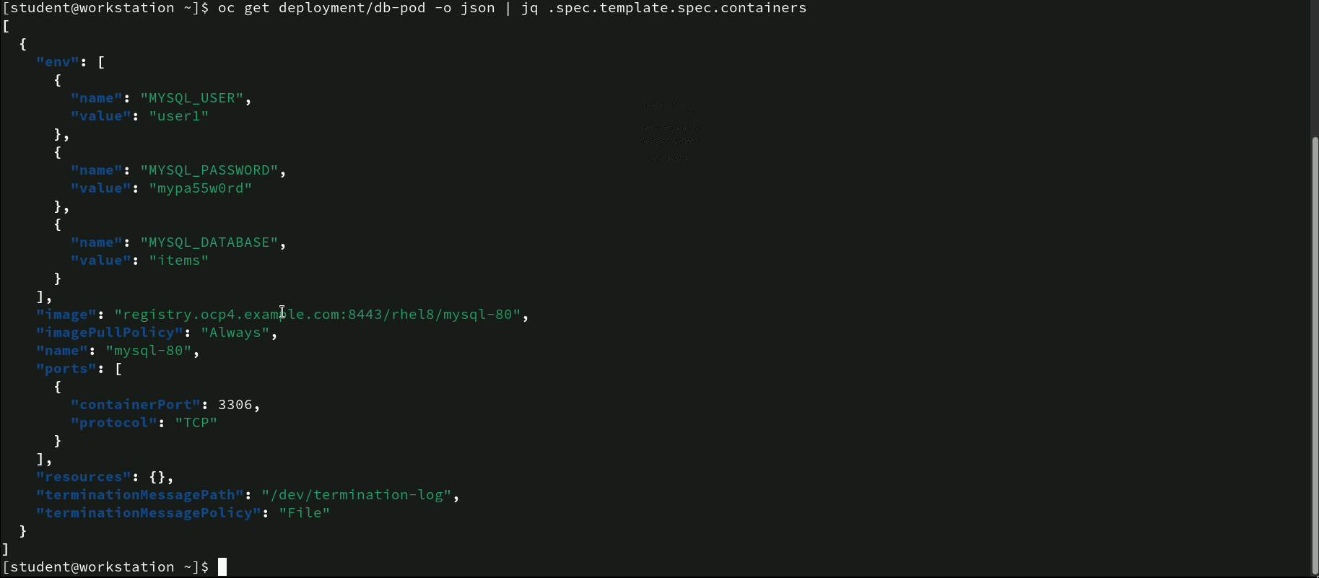
Command for inspecting deployment configuration for MySQL: oc get
- oc get deployment/db-pod -o json | jq .spec.template.spec.containers: This command retrieves the container specification details of the "db-pod" deployment in JSON format, filtered through `jq` for better readability. The command shows the “db-pod” MySQL container with user1 as the user, “mypa55w0rd” as the password, and “items” as the database. It uses the image registry.ocp4.example.com:8443/rhel8/mysql-80, pulls “Always,” exposes port 3306, and logs termination messages to /dev/termination-log.

Slide 27
Command for attaching persistent storage to a deployment
- oc set volumes deployment/db-pod --add --name nfs-volume-storage --type pvc --claim-mode rwo --claim-size 1Gi --mount-path /var/lib/mysql: This command attaches a persistent volume to the “db-pod” deployment:
• --name nfs-volume-storage: Names the volume.
• --type pvc: Indicates the volume type is a PersistentVolumeClaim (PVC).
• --claim-mode rwo: Sets the access mode to “ReadWriteOnce” (RWO).
• --claim-size 1Gi: Requests a 1Gi capacity for the PVC.
• --mount-path /var/lib/mysql: Specifies the mount path inside the pod.
- oc get pvc: This command lists the PersistentVolumeClaim details:
• db-pod-pvc: The name of the PVC.
• STATUS: Shows as “Bound,” indicating that the claim is successfully attached to a volume.
• CAPACITY: The allocated size is 1Gi.
• ACCESS MODES: Displays “RWO,” confirming the read-write access for one node.
• STORAGECLASS: Uses “nfs-storage,” indicating the storage class assigned.
• AGE: Indicates the PVC has been bound for 44 seconds.

Slide 28
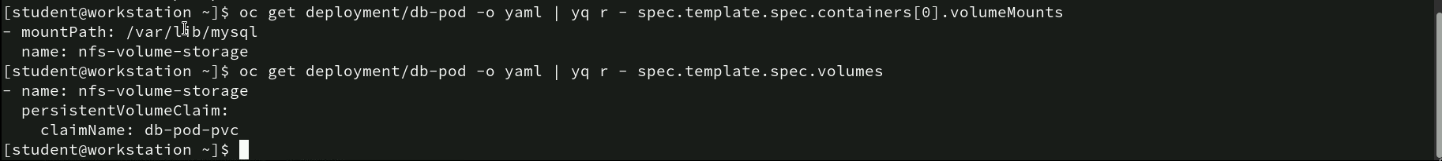
Command for verifying volume mount and pvc in deployment
oc get deployment/db-pod -o yaml | yq r - spec.template.spec.containers[0].volumeMounts: This command retrieves the volume mount details of the container within the “db-pod” deployment.
oc get deployment/db-pod -o yaml | yq r - spec.template.spec.volumes: This command extracts the volume configuration details from the deployment specification.

Slide 29
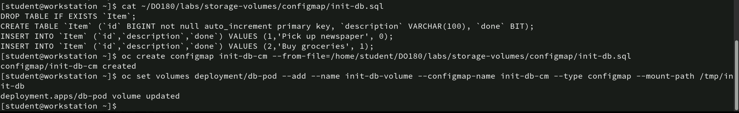
Command for configuring database initialization using configMap
The cat command displays the content of init-db.sql: The script drops an existing Item table if it exists.
oc create configmap init-db-cm --from-file=/home/student/DO180/labs/storage-volumes/configmap/init-db.sql: This command creates a ConfigMap named init-db-cm from the init-db.sql file, making the SQL initialization script available for use in the deployment.
oc set volumes deployment/db-pod --add --name init-db-volume --configmap-name init-db-cm --type configmap --mount-path /tmp/init-db: This command mounts the init-db-cm ConfigMap as a volume named init-db-volume to the “db-pod” deployment. The --mount-path /tmp/init-db specifies where the SQL script will be available inside the container.

Slide 30
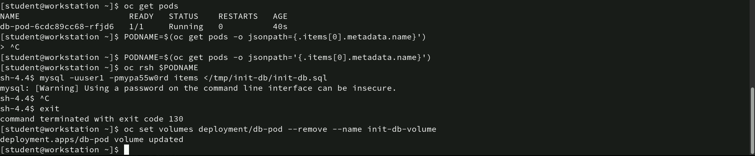
Command for verifying and removing Initialization Script in Pod
PODNAME=$(oc get pods -o jsonpath='{.items[0].metadata.name}’): This command captures the pod name into the variable PODNAME.
oc rsh $PODNAME: This command initiates an interactive remote shell session within the “db-pod.”
mysql --user1 --mypa55w0rd items < /tmp/init-db/init-db.sql: This command runs the SQL initialization script located at /tmp/init-db/init-db.sql against the MySQL database named “items” using the credentials provided (user1/mypa55w0rd).
oc set volumes deployment/db-pod --remove --name init-db-volume: This command removes the ConfigMap volume named init-db-volume from the “db-pod” deployment.

Slide 31
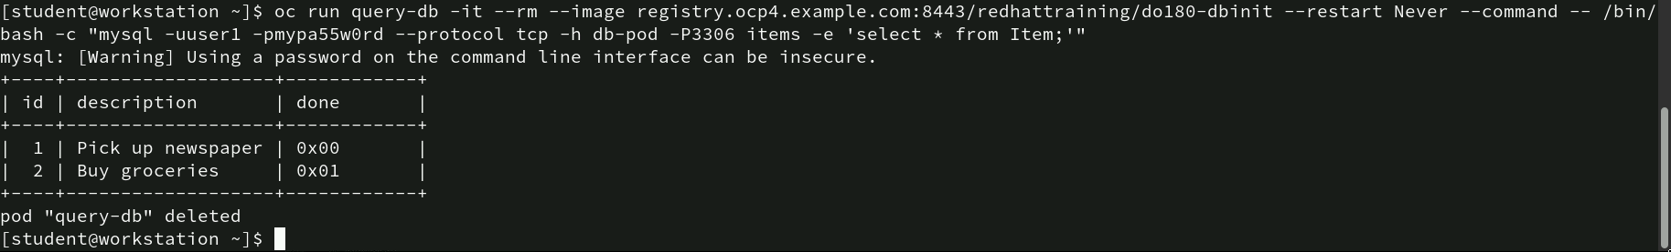
Command for querying data from MySQL Pod
oc run query-db -it --rm --image registry.ocp4.example.com:8443/redhattraining/do180-dbinit --restart Never --command -- /bin/bash -c "mysql -uuser1 -pmypa55w0rd -h db-pod -P3306 items -e 'select * from Item;’”: This command creates and runs a temporary pod named query-db using the specified image to execute a MySQL query
The results display two rows from the Item table
The --rm flag ensures that the query-db pod is automatically deleted after the command execution is complete.

Slide 32
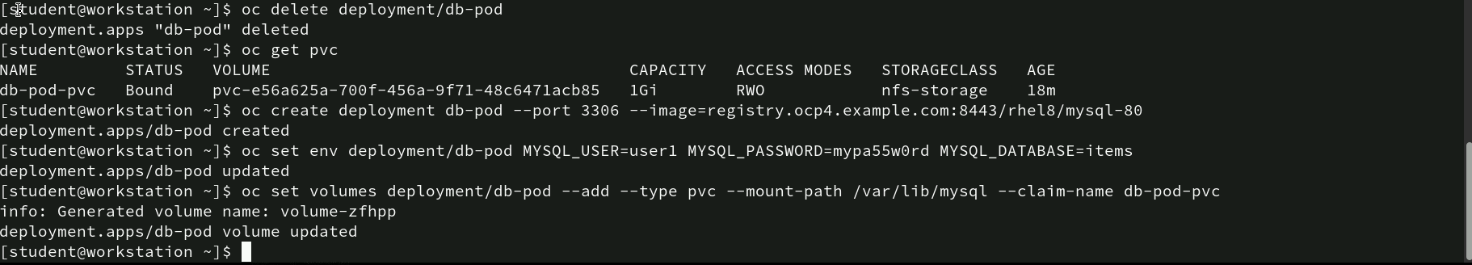
Command for recreating MySQL Deployment with persistent storage
oc delete deployment/db-pod: This command deletes the “db-pod” deployment, removing the associated pods but leaving the PersistentVolumeClaim (PVC) intact.
oc get pvc: Confirms that the PVC db-pod-pvc is still bound with a capacity of 1Gi, an access mode of RWO, and using the nfs-storage storage class.
oc create deployment db-pod --port 3306 --image=registry.ocp4.example.com:8443/rhel8/mysql-80: This command recreates the “db-pod” deployment with the MySQL 8.0 image, exposing port 3306.
oc set env deployment/db-pod MYSQL_USER=user1 MYSQL_PASSWORD=mypa55w0rd MYSQL_DATABASE=items: Sets the necessary MySQL environment variables.
oc set volumes deployment/db-pod --add --type pvc --mount-path /var/lib/mysql --claim-name db-pod-pvc: This command attaches the existing PVC db-pod-pvc to the new deployment at the mount path /var/lib/mysql, ensuring data persistence for the MySQL database.

Slide 33
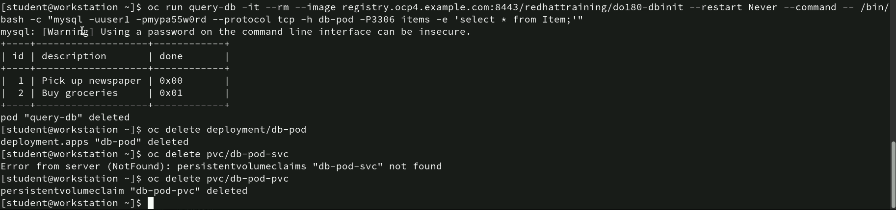
Command for querying data and cleaning up resources
oc run query-db -it --rm --image registry.ocp4.example.com:8443/redhattraining/do180-dbinit --restart Never --command -- /bin/bash -c "mysql -uuser1 -pmypa55w0rd -h db-pod -P3306 items -e 'select * from Item;’”: This command runs a temporary pod query-db to execute a MySQL query. It connects to the “db-pod” and retrieves all records from the Item table.
oc delete deployment/db-pod: This command deletes the “db-pod” deployment, removing associated resources.

Slide 34
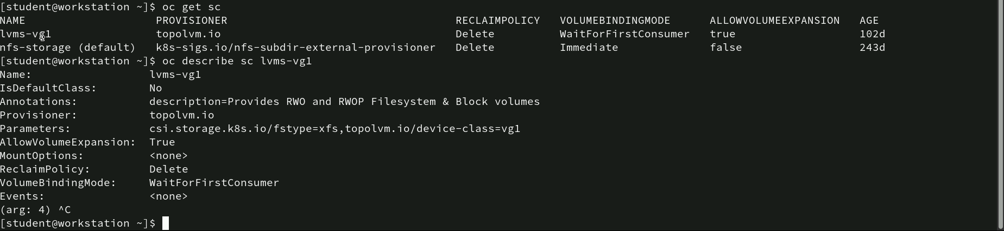
Command for viewing and describing storage classes
oc get sc: This command lists all storage classes available in the OpenShift cluster details.
oc describe sc lvms-vg1: This command provides detailed information about the lvms-vg1 storage class. The storage class “lvms-vg1” uses the “topolvm.io” provisioner and allows volume expansion, as indicated by AllowVolumeExpansion: True. Its ReclaimPolicy is set to “Delete,” meaning the volume will be deleted when the PersistentVolumeClaim (PVC) is removed. The VolumeBindingMode is “WaitForFirstConsumer,” so the volume is bound only when requested by a pod. It has parameters csi.storage.k8s.io/fstype=ext4 for the filesystem type and topolvm.io/device-class=vg1 for the device class.

Slide 35
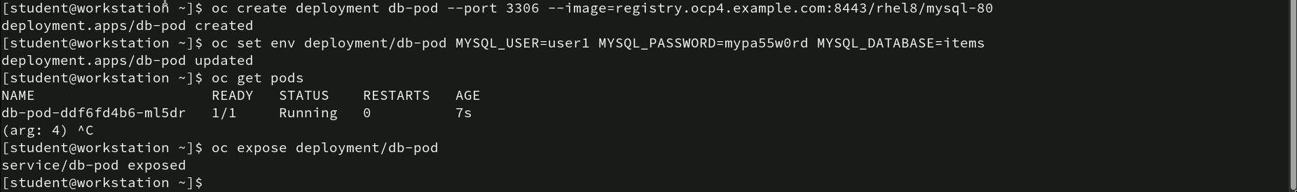
Command for creating configuring, and exposing MySQL Deployment
oc create deployment db-pod --port 3306 --image=registry.ocp4.example.com:8443/rhel8/mysql-80: This command creates a deployment named db-pod using the MySQL 8.0 image, exposing port 3306 for database access.
oc set env deployment/db-pod MYSQL_USER=user1 MYSQL_PASSWORD=mypa55w0rd MYSQL_DATABASE=items: Sets environment variables for the MySQL deployment.
oc get pods: Displays the status of the running pod named db-pod-ddf6fd4b6-ml5dr, showing it is ready (1/1), running, with 0 restarts, and an age of 7 seconds.
oc expose deployment/db-pod: Creates a service to expose the db-pod deployment, making it accessible within the OpenShift network.

Slide 36
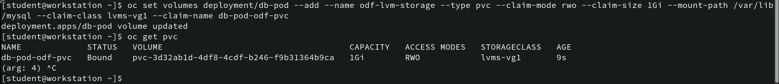
Command for attaching persistent Volume to deployment
- oc set volumes deployment/db-pod --add --name odf-lvm-storage --type pvc --claim-mode rwo --claim-size 1Gi --mount-path /var/lib/mysql --claim-class lvms-vg1 --claim-name db-pod-odf-pvc: This command adds a persistent volume to the “db-pod” deployment:
• --name odf-lvm-storage: Names the volume.
• --type pvc: Specifies that the volume is a PersistentVolumeClaim (PVC).
• --claim-mode rwo: Access mode set to “ReadWriteOnce” (RWO).
• --claim-size 1Gi: Allocates a 1Gi capacity.
• --claim-class lvms-vg1: Uses the storage class “lvms-vg1”.
• --mount-path /var/lib/mysql: Mounts the volume at /var/lib/mysql inside the pod.
- oc get pvc: Confirms that the PVC db-pod-odf-pvc is successfully bound with:
• CAPACITY: 1Gi
• ACCESS MODES: RWO
• STORAGECLASS: lvms-vg1
• AGE: 9 seconds

Slide 37
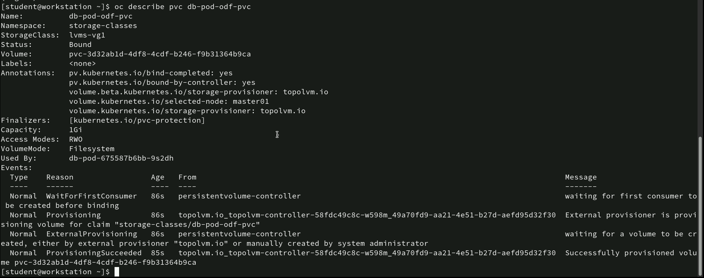
Command for describing PersistentVolumeClaim details
- oc describe pvc db-pod-odf-pvc: This command provides detailed information about the PVC named db-pod-odf-pvc. It uses the “lvms-vg1” storage class, is bound to the volume “pvc-3d32ab1d-4df8-4cdf-b246-f9b31364b9ca,” has a capacity of 1Gi, and an RWO access mode with a filesystem volume mode. Annotations indicate binding completion, the “topolvm.io” provisioner, and selection of node “master01.” Events show it waited for a pod before binding, with provisioning successfully completed by “topolvm-controller.”

Slide 38
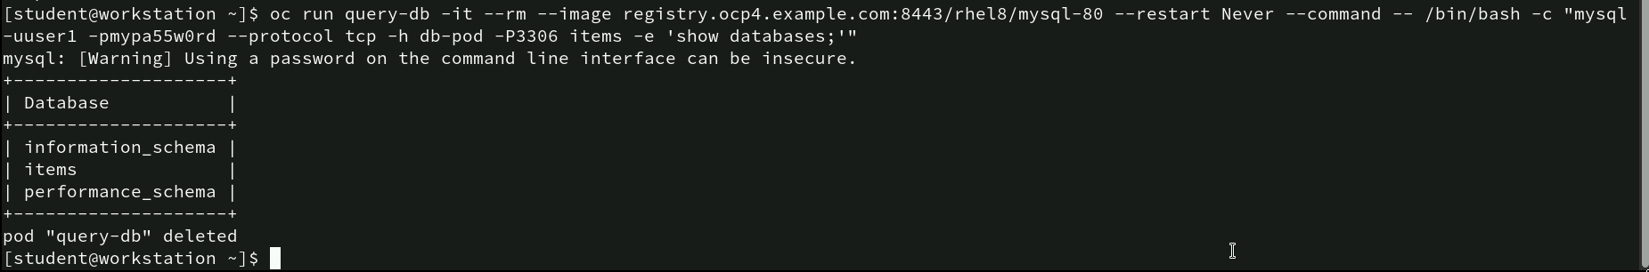
Command for inspecting job template using YAML: oc get job
oc run query-db -it --rm --image registry.ocp4.example.com:8443/rhel8/mysql-80 --restart Never --command -- /bin/bash -c "mysql -uuser1 -pmypa55w0rd --protocol tcp -h db-pod -P3306 items -e 'show databases;’”: The oc run query-db command creates a temporary pod named “query-db” in interactive mode (-it), automatically deleting it after completion (--rm). It uses the MySQL image registry.ocp4.example.com:8443/rhel8/mysql-80 and executes a MySQL command to log in as user1 with password mypa55w0rd, connecting to “db-pod” on port 3306. The command items -e 'show databases;' lists the databases: information_schema, items, and performance_schema.

Slide 39
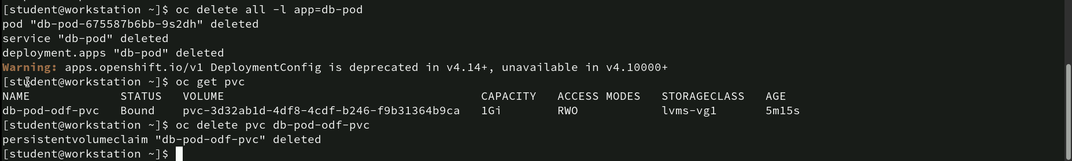
Command for deleting resources and pvc
oc delete all -l app=db-pod: Deletes all resources (pods, services, deployments, etc.) associated with the label app=db-pod.
oc get pvc: Lists all the current persistent volume claims (PVCs), showing db-pod-odf-pvc with details such as status (Bound), capacity (1Gi), access modes (RWO), and storage class.
oc delete pvc db-pod-odf-pvc: Deletes the specified PVC named db-pod-odf-pvc.

Slide 40
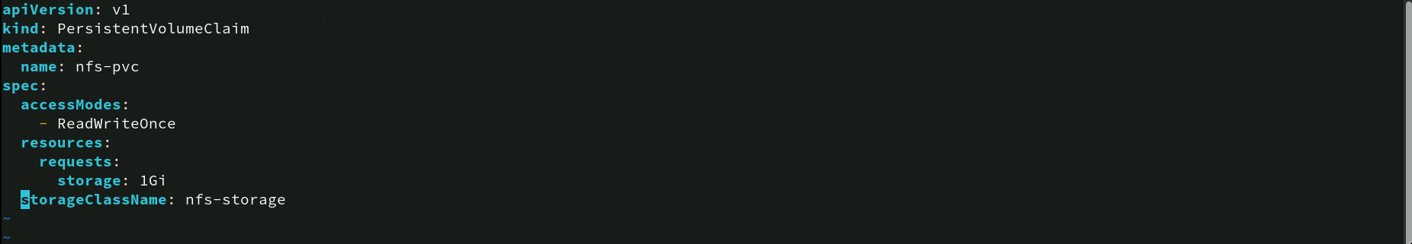
PVC configuration for nfs storage
• apiVersion: v1: Specifies that this configuration file is using version 1 of the Kubernetes API.
• kind: PersistentVolumeClaim: Indicates that this resource is a PersistentVolumeClaim (PVC).
• metadata: Contains metadata about the PVC.
• name: nfs-pvc: Names this PVC as nfs-pvc.
• spec: Details the specifications for the PVC.
• accessModes: ReadWriteOnce: Specifies that the volume can be mounted as read-write by a single node.
• resources: Defines the storage resources requested.
• requests: storage: 1Gi: Requests 1 GiB of storage.
• storageClassName: nfs-storage: Specifies the storage class name as nfs-storage, indicating that this PVC will use an NFS storage backend.

Slide 41
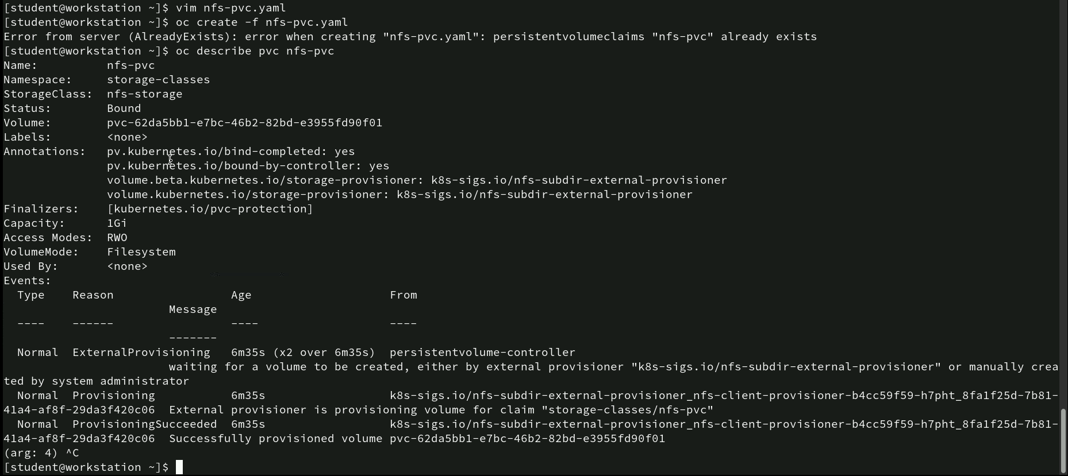
Command for describing a PVC
vim nfs-pvc.yaml: Opens the nfs-pvc.yaml file for editing using the vim editor.
oc create -f nfs-pvc.yaml: Attempts to create the PVC from the nfs-pvc.yaml file but results in an error because the PVC nfs-pvc already exists.
oc describe pvc nfs-pvc: Provides detailed information about the nfs-pvc PVC.

Slide 42
Command for creating and exposing deployment
- oc create deployment web-pod --port 8080 --image=registry.ocp4.example.com:8443/ubi8/httpd-24:1-215: Creates a deployment named web-pod using the specified image registry.ocp4.example.com:8443/ubi8/httpd-24:1-215 from the OpenShift image registry, and sets the container to listen on port 8080.
• oc expose deployment web-pod: Exposes the web-pod deployment, creating a service that makes it accessible externally.

Slide 43
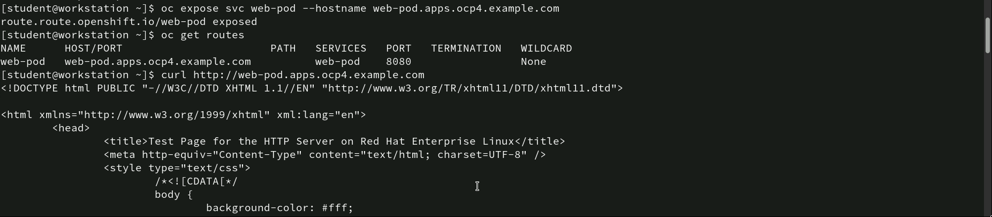
Command for exposing and testing a service
oc expose svc web-pod --hostname web-pod.apps.ocp4.example.com: Exposes the service web-pod with a specific hostname web-pod.apps.ocp4.example.com, creating a route to access the application externally.
oc get routes: Lists the existing routes, showing that the web-pod service is accessible at web-pod.apps.ocp4.example.com on port 8080.
curl http://web-pod.apps.ocp4.example.com: Uses the curl command to access the web page hosted by the web-pod service. The HTML output confirms that the service is up and running, displaying a “Test Page for the HTTP Server on Red Hat Enterprise Linux.”

Slide 44
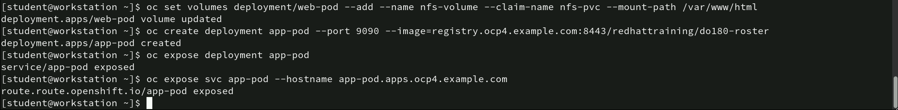
Command for configuring volumes and exposing deployments
oc set volumes deployment/web-pod --add --name nfs-volume --claim-name nfs-pvc --mount-path /var/www/html: Adds a volume named nfs-volume to the web-pod deployment using the existing PVC nfs-pvc and mounts it at the path /var/www/html.
oc create deployment app-pod --port 9090 --image=registry.ocp4.example.com:8443/redhattraining/do180-roster: Creates a new deployment named app-pod using the specified image and sets it to listen on port 9090.
oc expose deployment app-pod: Exposes the app-pod deployment as a service, making it accessible internally.
oc expose svc app-pod --hostname app-pod.apps.ocp4.example.com: Exposes the app-pod service externally with the hostname app-pod.apps.ocp4.example.com.

Slide 45
Command for adding a volume to a deployment
oc set volumes deployment/app-pod --add --name nfs-volume --claim-name nfs-pvc --mount-path /var/tmp: Adds a volume named nfs-volume to the app-pod deployment using the existing PVC nfs-pvc and mounts it at the path /var/tmp.
deployment.apps/app-pod volume updated: Confirms that the volume has been successfully added to the app-pod deployment.

Slide 46
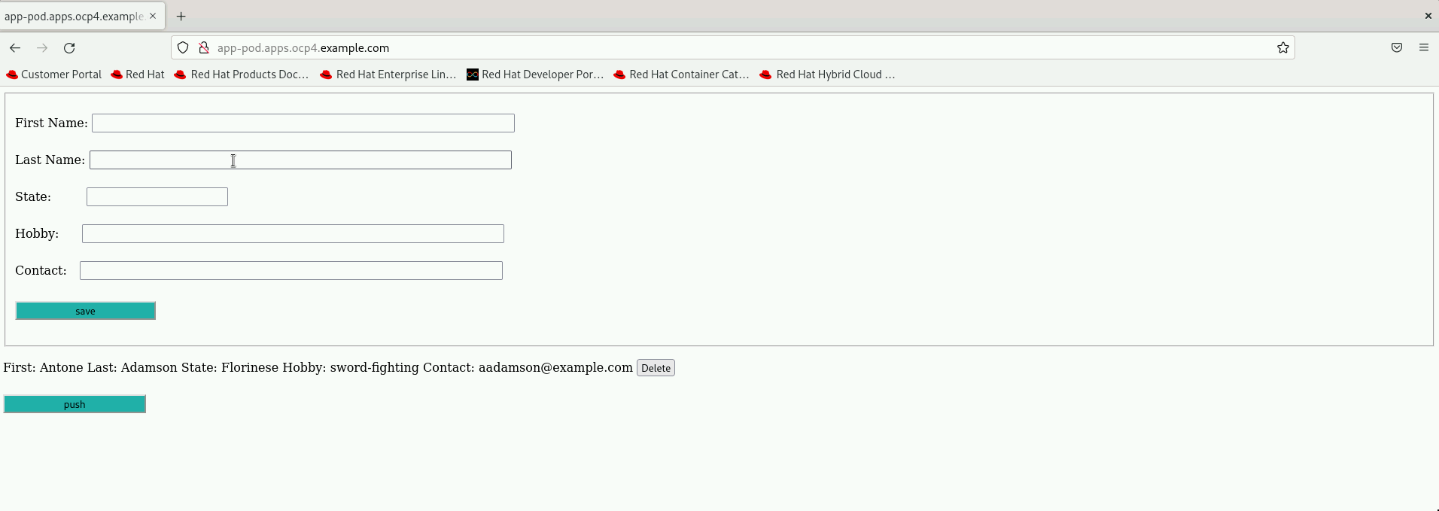
Web application interface for data entry
The screenshot displays a web application hosted at app-pod.apps.ocp4.example.com, featuring a form for data entry with fields.

Slide 47
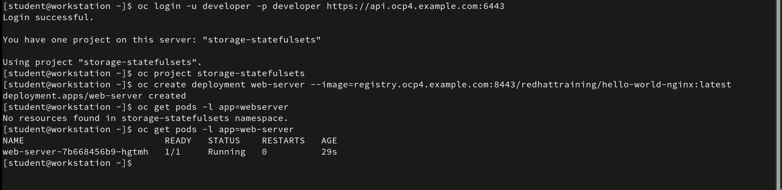
Commands for creating a deployment
oc create deployment web-server --image=registry.ocp4.example.com:8443/redhattraining/hello-world-nginx:latest: Creates a deployment named web-server using the hello-world-nginx image from the specified registry.
oc get pods -l app=web-server (run again): Displays the running pod associated with the web-server deployment, showing it is in a Running state with the pod name web-server-7b668456b9-hgtmh.

Slide 48
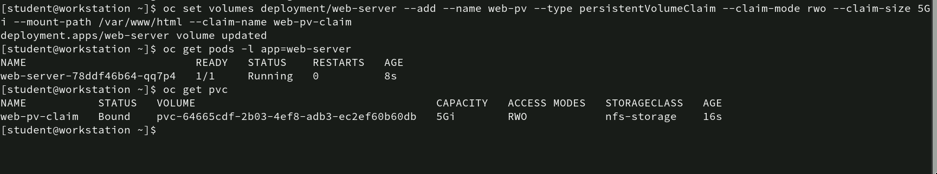
Commands for adding PVC to deployment
oc set volumes deployment/web-server --add --name web-pv --type persistentVolumeClaim --claim-name web-pv-claim --claim-size 5Gi --mount-path /var/www/html --claim-mode rwo: Adds a persistent volume named web-pv to the web-server deployment using a PersistentVolumeClaim (PVC) named web-pv-claim with a requested size of 5Gi. It sets the volume to be mounted at /var/www/html with ReadWriteOnce (RWO) access mode.
oc get pods -l app=web-server: Displays the pod related to the web-server deployment, indicating it is running with the name web-server-78ddf46b64-qq7p4.
oc get pvc: Lists the PVCs in the current project, showing that web-pv-claim is Bound to a volume with a capacity of 5Gi and is using the nfs-storage storage class.

Slide 49
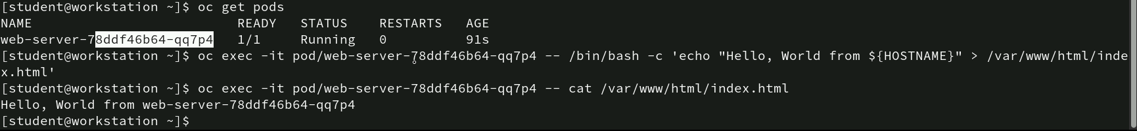
Command for modifying and accessing file in a running pod
oc get pods: Lists the pods in the current project, showing that the web-server-78ddf46b64-qq7p4 pod is running.
oc exec -it pod/web-server-78ddf46b64-qq7p4 -- /bin/bash -c 'echo "Hello, World from ${HOSTNAME}" > /var/www/html/index.html': Executes a command inside the web-server pod to create or overwrite the index.html file in the /var/www/html directory with the text “Hello, World from [HOSTNAME]” (where ${HOSTNAME} is replaced with the pod’s hostname, web-server-78ddf46b64-qq7p4).
oc exec -it pod/web-server-78ddf46b64-qq7p4 -- cat /var/www/html/index.html: Executes another command inside the pod to display the contents of the index.html file, confirming that the file contains “Hello, World from web-server-78ddf46b64-qq7p4”.

Slide 50
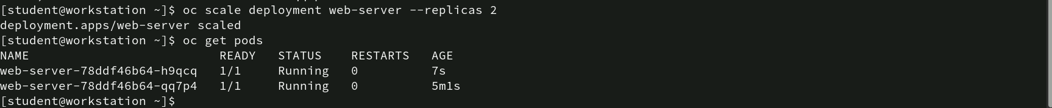
Command for scaling deployment
oc scale deployment web-server --replicas 2: Scales the web-server deployment to have 2 replicas, meaning there will be two instances (pods) of the web-server running.
oc get pods: Lists the pods, showing that there are now two running instances of the web-server deployment.

Slide 51
Command for verifying data consistency across scaled pods
oc exec -it pod/web-server-78ddf46b64-qq7p4 -- cat /var/www/html/index.html: Displays the content of the index.html file from the first pod (web-server-78ddf46b64-qq7p4). The output shows “Hello, World from web-server-78ddf46b64-qq7p4”.
oc exec -it pod/web-server-78ddf46b64-h9qcq -- cat /var/www/html/index.html: Displays the content of the index.html file from the second pod (web-server-78ddf46b64-h9qcq). The output is the same, “Hello, World from web-server-78ddf46b64-qq7p4”.

Slide 52
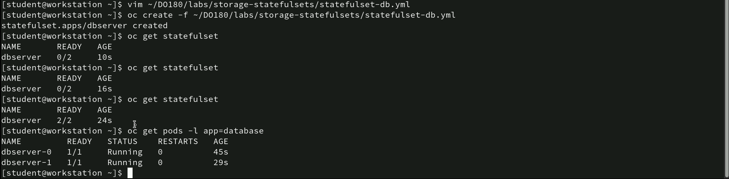
Command for creating and verifying a statefulset
vim ~/DO180/labs/storage-statefulsets/statefulset-db.yml: Opens the statefulset-db.yml file for editing using the vim editor.
oc create -f ~/DO180/labs/storage-statefulsets/statefulset-db.yml: Creates a StatefulSet named dbserver using the specified YAML file.
oc get statefulset: Displays the status of the StatefulSet dbserver, initially showing 0/2 pods as ready, indicating that the pods are still being created.
oc get pods -l app=database: Lists the pods with the label app=database.

Slide 53
Commands for executing MySQL Commands in Pods
oc exec -it pod/dbserver-0 -- /bin/bash -c "mysql -uredhat -predhat123 sakila -e 'create table items (count INT);'": Executes a command inside the dbserver-0 pod to create a new table named items with a single column count of type INT in the sakila database using MySQL credentials (username: redhat, password: redhat123).
oc exec -it pod/dbserver-1 -- /bin/bash -c "mysql -uredhat -predhat123 sakila -e 'create table inventory (count INT);'": Executes a similar command in the dbserver-1 pod to create another table named inventory with a column count of type INT in the sakila database.

Slide 54
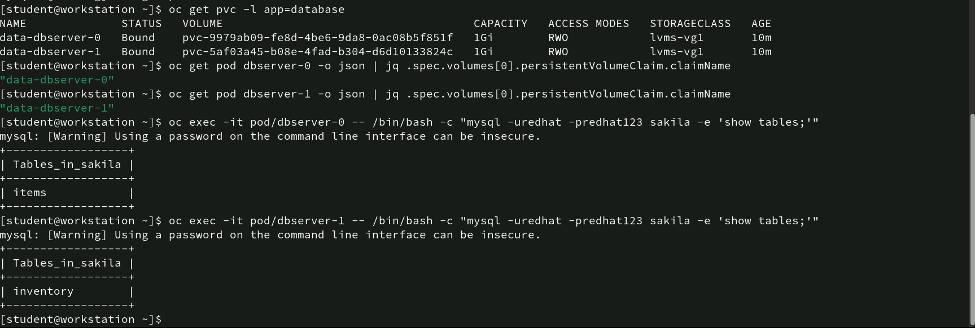
Commands for verifying PVC and database tables
oc get pvc -l app=database: Lists the PersistentVolumeClaims (PVCs) with the label app=database.
oc get pod dbserver-1 -o json | jq .spec.volumes[0].persistentVolumeClaim.claimName: Retrieves the claim name for dbserver-1, confirming it’s associated with data-dbserver-1.
oc exec -it pod/dbserver-0 -- /bin/bash -c "mysql -uredhat -predhat123 sakila -e 'show tables;'": Executes a MySQL command inside dbserver-0 to display tables in the sakila database, showing the items table.
oc exec -it pod/dbserver-1 -- /bin/bash -c "mysql -uredhat -predhat123 sakila -e 'show tables;'": Executes a MySQL command inside dbserver-1 to display tables, showing the inventory table.

Slide 55
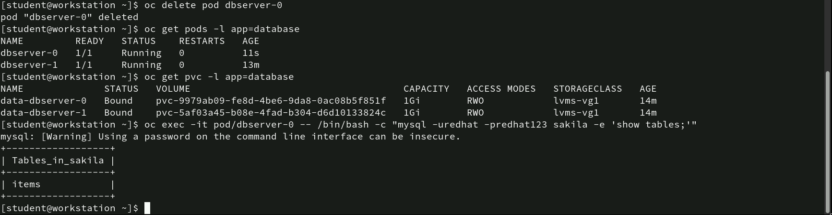
Commands for deleting and recovering a pod
oc delete pod dbserver-0: Deletes the dbserver-0 pod.
oc get pvc -l app=database: Confirms that the PVCs data-dbserver-0 and data-dbserver-1 remain Bound, indicating that persistent storage was not lost despite the pod deletion.
oc exec -it pod/dbserver-0 -- /bin/bash -c "mysql -uredhat -predhat123 sakila -e 'show tables;'": Executes a MySQL command inside the recreated dbserver-0 pod to display the tables in the sakila database, confirming that the items table still exists.

Slide 56
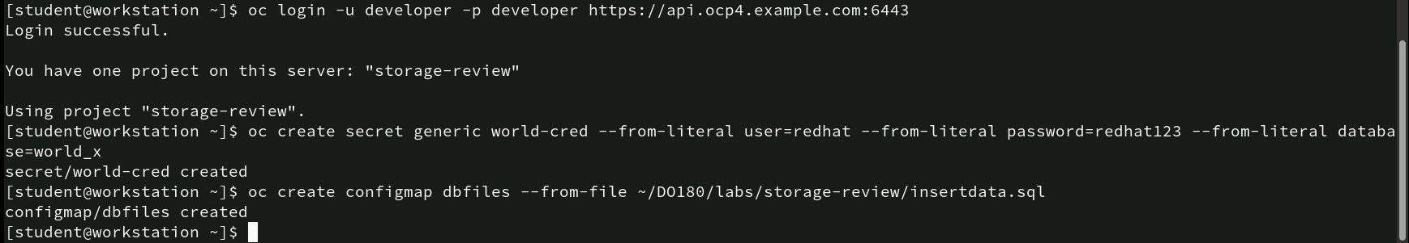
Commands for creating secrets and configmaps
oc create secret generic world-cred --from-literal user=redhat --from-literal password=redhat123 --from-literal database=world_x: Creates a secret named world-cred with literal values for user, password, and database.
oc create configmap dbfiles --from-file ~/DO180/labs/storage-review/insertdata.sql: Creates a ConfigMap named dbfiles using the insertdata.sql file located in the specified path.

Slide 57
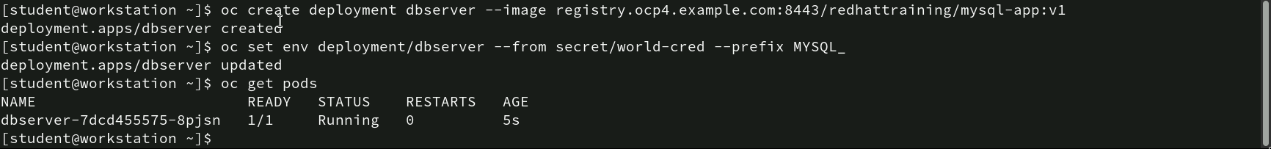
Commands for creating a deployment and injecting secrets as env variables
oc create deployment dbserver --image registry.ocp4.example.com:8443/redhattraining/mysql-app:v1: Creates a deployment named dbserver using the specified MySQL image.
oc set env deployment/dbserver --from secret/world-cred --prefix MYSQL_: Sets environment variables for the dbserver deployment using the world-cred secret, adding the MYSQL_ prefix to each variable. This results in environment variables like MYSQL_USER, MYSQL_PASSWORD, and MYSQL_DATABASE.
oc get pods: Lists the pods, showing that the dbserver pod is running with the name dbserver-7dcd455575-8pjsn.

Slide 58
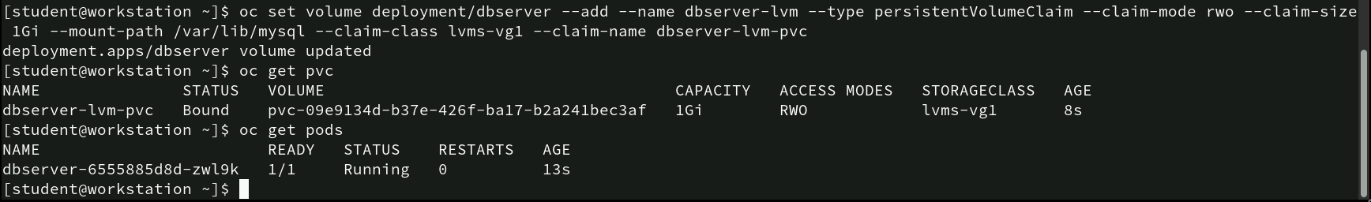
Commands for attaching PVC to a deployment
oc set volume deployment/dbserver --add --name dbserver-lvm --type persistentVolumeClaim --claim-mode rwo --claim-size 1Gi --mount-path /var/lib/mysql --claim-class lvms-vgl --claim-name dbserver-lvm-pvc: Adds a persistent volume named dbserver-lvm to the dbserver deployment using a PVC with the name dbserver-lvm-pvc. The volume is set to ReadWriteOnce (RWO) mode, has a size of 1Gi, and is mounted at /var/lib/mysql.
oc get pvc: Displays the PVCs, confirming that dbserver-lvm-pvc is Bound to a volume with a capacity of 1Gi using the lvms-vgl storage class.
oc get pods: Lists the pods, showing that the dbserver-6558858d8d-zwl9k pod is running and has been updated with the newly attached volume.

Slide 59
Commands for mounting a configMap as a volume in deployment
oc set volume deployment/file-sharing --add --name config-map-vpc --type configmap --configmap-name dbfiles --mount-path /home/database-files: Adds a volume named config-map-vpc to the file-sharing deployment using the ConfigMap dbfiles. The volume is mounted at the path /home/database-files.

Slide 60
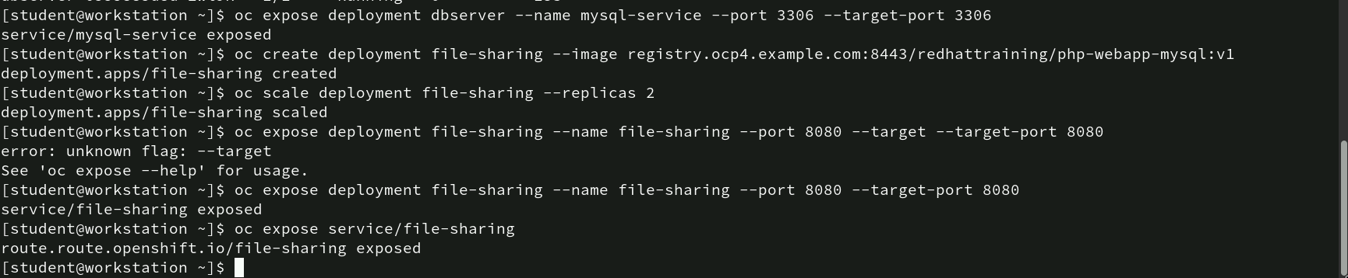
Commands for creating, scaling and exposing deployment
oc expose deployment dbserver --name mysql-service --port 3306 --target-port 3306: Exposes the dbserver deployment as a service named mysql-service on port 3306.
oc create deployment file-sharing --image registry.ocp4.example.com:8443/redhattraining/php-webapp-mysql:v1: Creates a deployment named file-sharing using the specified PHP web application image.
oc scale deployment file-sharing --replicas 2: Scales the file-sharing deployment to 2 replicas.
oc expose deployment file-sharing --name file-sharing --port 8080 --target-port 8080: Re-executes the command correctly, successfully exposing the service.
oc expose service/file-sharing: Creates a route to expose the file-sharing service externally.

Slide 61
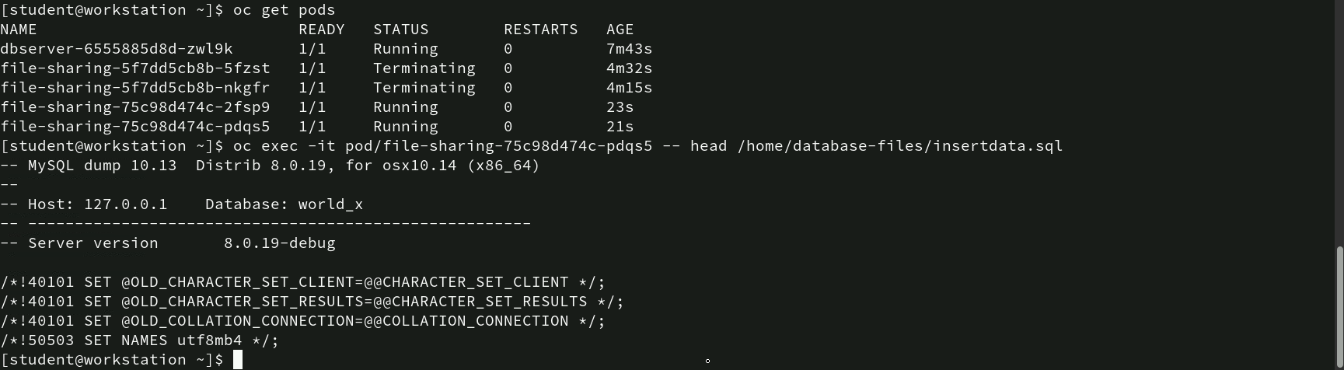
Commands for verifying pod status and accessing data
oc get pods: Displays the current pods.
oc exec -it pod/file-sharing-75c98d474c-pdqs5 -- head /home/database-files/insertdata.sql: Executes a command inside the file-sharing pod to display the first few lines of the insertdata.sql file stored at /home/database-files.

Slide 62
Commands for adding a pvc to a deployment
- oc set volume deployment/file-sharing --add --name shared-volume --type persistentVolumeClaim --claim-mode rwo --claim-size 1Gi --mount-path /home/sharedfiles --claim-class nfs-storage --claim-name shared-pvc: Adds a volume named shared-volume to the file-sharing deployment using a PersistentVolumeClaim (PVC) with the name shared-pvc. The volume is set to ReadWriteOnce (RWO) access mode, has a size of 1Gi, uses the nfs-storage storage class, and is mounted at /home/sharedfiles.

Slide 63
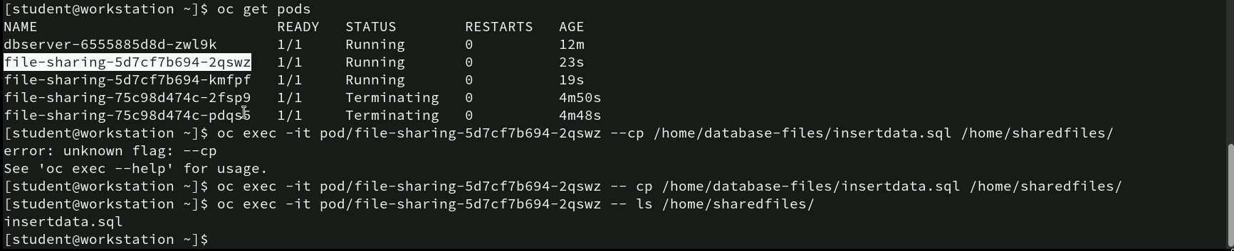
Commands for copying and verifying file transferring in pods
oc get pods: Lists the current pods, showing the dbserver pod and multiple file-sharing pods, with two of them running and two terminating.
oc exec -it pod/file-sharing-5d7cf7b694-2qswz -- cp /home/database-files/insertdata.sql /home/sharedfiles/: Correctly copies the insertdata.sql file from the source to the destination directory within the pod.
oc exec -it pod/file-sharing-5d7cf7b694-2qswz -- ls /home/sharedfiles/: Lists the contents of /home/sharedfiles/ to verify that insertdata.sql is successfully copied.

Slide 64
Commands for removing a volume from a deployment
- oc set volume deployment/file-sharing --remove --name=config-map-vpc: Removes the volume named config-map-vpc from the file-sharing deployment.
- deployment.apps/file-sharing volume updated: Confirms that the volume has been successfully removed from the file-sharing deployment.

Slide 65
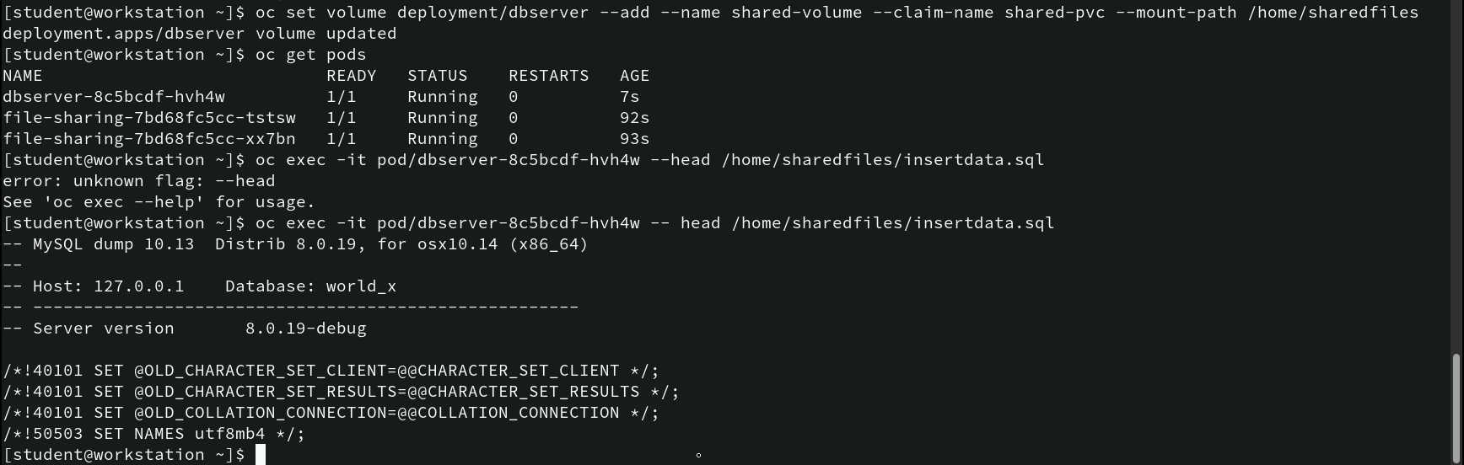
Commands for adding and verifying persistent volume in deployment
oc set volume deployment/dbserver --add --name shared-volume --claim-name shared-pvc --mount-path /home/sharedfiles: Adds a volume named shared-volume to the dbserver deployment using the shared-pvc PersistentVolumeClaim and mounts it at /home/sharedfiles.
oc get pods: Lists the pods, showing that dbserver-8c5bcdf-hvh4w is running, along with two file-sharing pods.
oc exec -it pod/dbserver-8c5bcdf-hvh4w -- head /home/sharedfiles/insertdata.sql: Correctly executes the head command to display the first few lines of the insertdata.sql file, showing MySQL dump details, character set configurations, and database information.

Slide 66
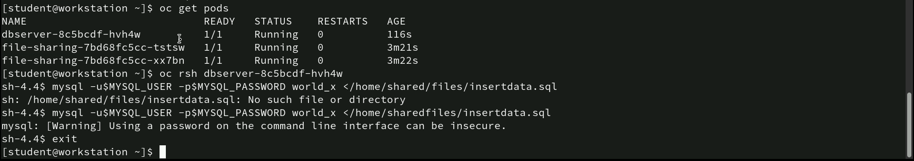
Commands for importing data into MySQL from a mounted volume
oc get pods: Lists the current pods, showing that dbserver-8c5bcdf-hvh4w and two file-sharing pods are running.
oc rsh dbserver-8c5bcdf-hvh4w: Opens a remote shell into the dbserver-8c5bcdf-hvh4w pod.
mysql -u$MYSQL_USER -p$MYSQL_PASSWORD world_x </home/sharedfiles/insertdata.sql: Successfully runs the import, with a warning that using a password on the command line can be insecure.

Slide 67
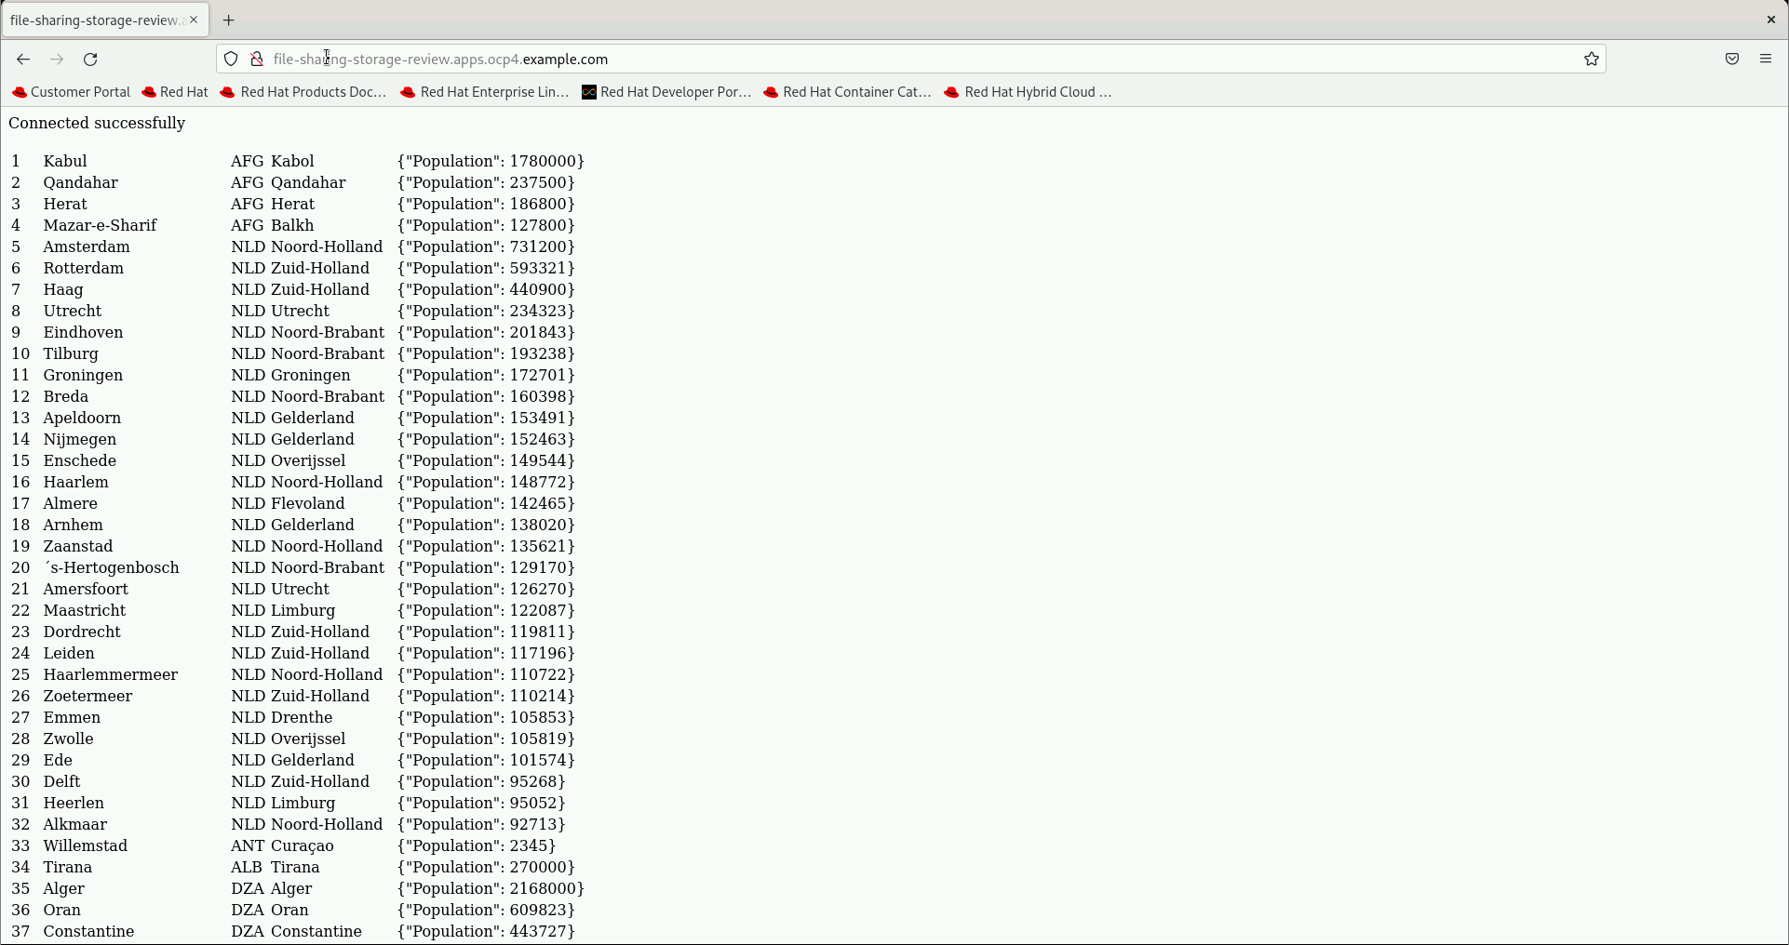
Displaying data from a database in a web application
The screenshot shows a web application interface hosted at file-sharing-storage-review.apps.ocp4.example.com. The page displays data retrieved from a database, indicating a successful connection with the message “Connected successfully.”

Slide 68
Thank You!

